Slide 1
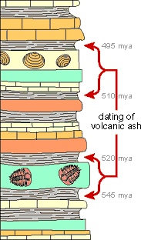
Relative and Absolute dating Quiz

Slide 2
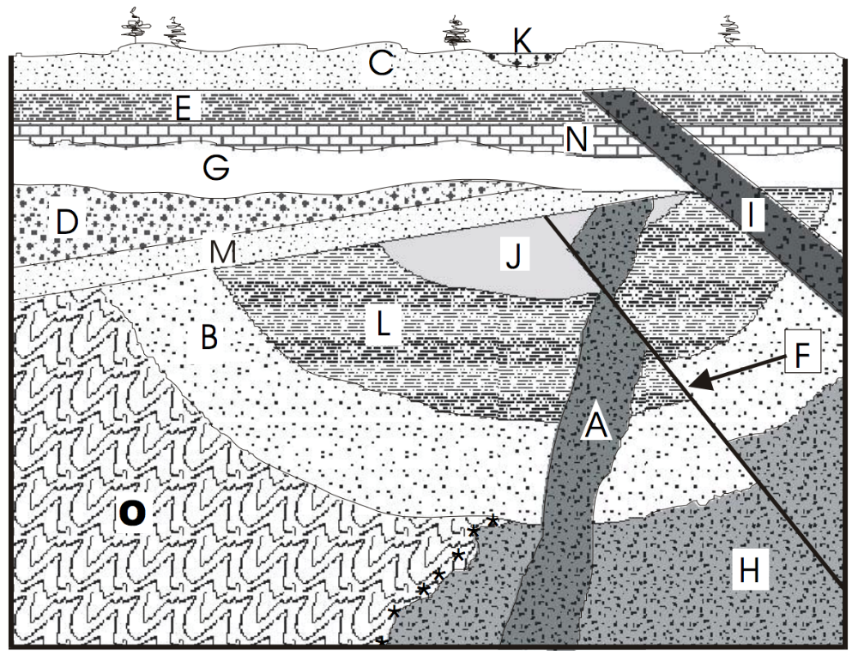
1. What is the correct order of geological features from youngest to oldest
a. F, G, M, A, H
b. G, M, F, A, H
c. G, M, A, H, F
d. H, A, F, M, G

Slide 3
2. Feature A. is an example of which kind of igneous intrusion?
a. sill
b. dike
c. batholith
d. volcanic neck

Slide 4
3. Which relative dating practice explains why feature F is younger than feature H?
a. Law of original horizontality
b. Principle of cross-cutting
c. Law of superposition
d. Law of inclusion

Slide 5
4. Which relative dating practice explains why feature G is younger than feature D?
a. Law of original horizontality
b. Principle of cross-cutting
c. Law of superposition
d. Law of inclusion

Slide 6
5. Radiometric dating is a reliable form of dating geologic events because rates of decay are ______________ and _____________.
predictable, consistent
reliable, predictable
exact, consistent
predictable, easy to measure

Slide 7
Radioactive Isotope | Daughter Isotope | Half-life (years) | Effective dating range (years)
Urainium-238 | Lead-206 | 4.5 billion | 10 million – 4.6 billion
Potassium-40 | Argon-40 | 1.3 billion | 50,000 – 4.6 billion
Carbon-14 | Nitrogen-14 | 5730 | 100 – 75,000
Half-life | Parent-Daughter ratio | Amount of parent remaining
0 | 1:0 | 1/0 = 100%
1 | 1:1 | 1/2 = 50%
2 | 1:3 | 1/4 = 25%
3 | 1:7 | 1/8 = 12.5%
6. A sample of charcoal from an archeological site contains approximately 1 atom of Carbon-14 for every 7 atoms of Nitrogen-14. Approximately how old is the site?
a. 23,000 years
b. 17,000 years
c. 11,000 years
d. 6,000 years

Slide 8
Radioactive Isotope | Daughter Isotope | Half-life (years) | Effective dating range (years)
Urainium-238 | Lead-206 | 4.5 billion | 10 million – 4.6 billion
Potassium-40 | Argon-40 | 1.3 billion | 50,000 – 4.6 billion
Carbon-14 | Nitrogen-14 | 5730 | 100 – 75,000
Half-life | Parent-Daughter ratio | Amount of parent remaining
0 | 1:0 | 1/0 = 100%
1 | 1:1 | 1/2 = 50%
2 | 1:3 | 1/4 = 25%
3 | 1:7 | 1/8 = 12.5%
7. What percentage of Potassium-40 would remain after 3.9 billion years?
100%
b. 50%
c. 25%
d. 12.5%

Slide 9
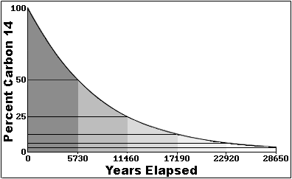
8. If a bone sample from an ancient saber-toothed cat contains 20% of its original Carbon-14 atoms, how much time has passed since the saber-toothed cat died?
a. 3,000 years b. 7,000 years c. 13,000 years d. 23,000 years

Slide 10
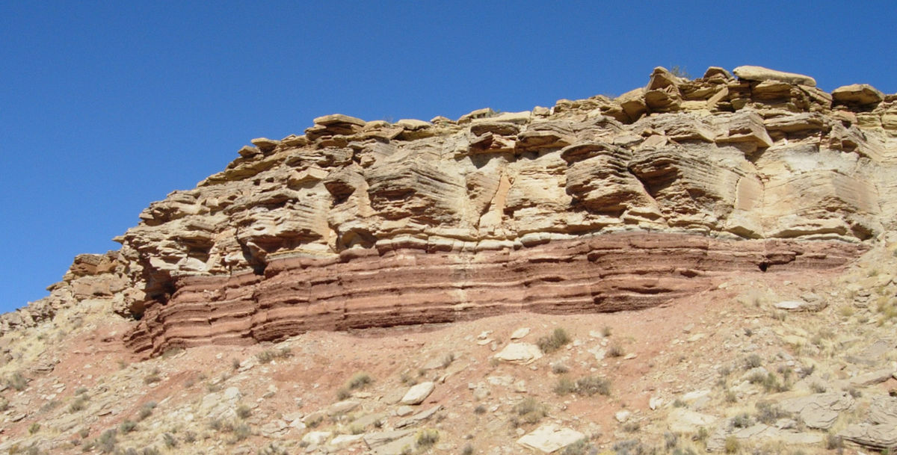
9. Why can’t sedimentary rock be dated with radiometric dating techniques?
a. Sedimentary rock is too young.
b. Sedimentary rock is made from other rocks and/or shells from living organisms.
c. Sedimentary rock does not contain radioactive isotopes.
d. Sedimentary rock is made of rock that does not decay.

Slide 11
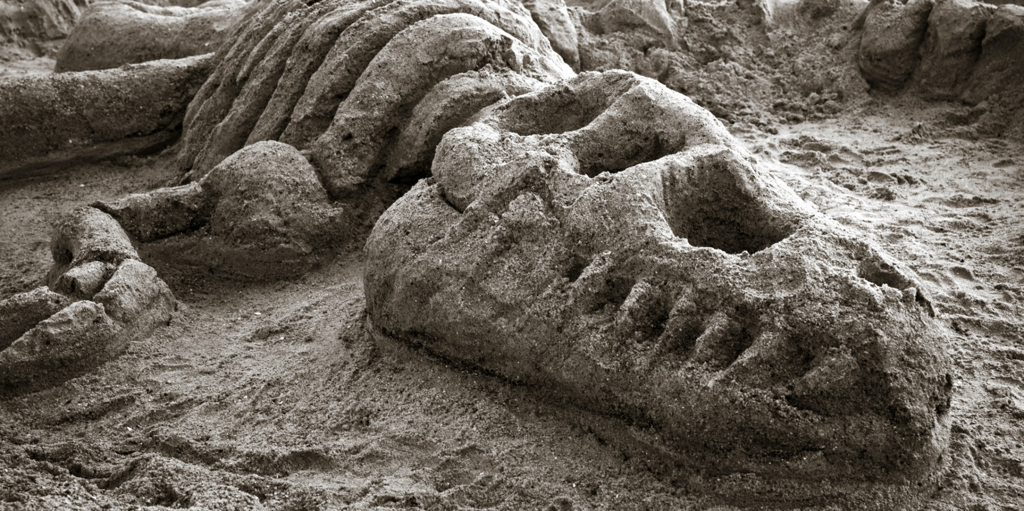
10. The news blog realscience4you.com reports that the first dinosaur skeleton was recently discovered on an 85-million-year-old volcanic peak in the Elkhorn mountains south of Helena, Montana. Is this possible (yes or no)?
Why or why not?
a. Yes, dinosaurs lived on Earth 85 million-years-ago.
b. Yes, the bones could be dated with radiocarbon dating.
c. No, fossils are only found in sedimentary rocks.
d. No, there have been no other fossils found on this mountain.

Slide 12
1. What is the correct order of geological features from youngest to oldest
a. F, G, M, A, H
b. G, M, F, A, H
c. G, M, A, H, F
d. H, A, F, M, G

Slide 13
2. Feature A. is an example of which kind of igneous intrusion?
a. sill
b. dike
c. batholith
d. volcanic neck

Slide 14
3. Which relative dating practice explains why feature F is younger than feature H?
a. Law of original horizontality
b. Principle of cross-cutting
c. Law of superposition
d. Law of inclusion

Slide 15
4. Which relative dating practice explains why feature G is younger than feature D?
a. Law of original horizontality
b. Principle of cross-cutting
c. Law of superposition
d. Law of inclusion

Slide 16
5. Radiometric dating is a reliable form of dating geologic events because rates of decay are ______________ and _____________.
predictable, consistent
reliable, predictable
exact, consistent
predictable, easy to measure

Slide 17
Radioactive Isotope | Daughter Isotope | Half-life (years) | Effective dating range (years)
Urainium-238 | Lead-206 | 4.5 billion | 10 million – 4.6 billion
Potassium-40 | Argon-40 | 1.3 billion | 50,000 – 4.6 billion
Carbon-14 | Nitrogen-14 | 5730 | 100 – 75,000
Half-life | Parent-Daughter ratio | Amount of parent remaining
0 | 1:0 | 1/0 = 100%
1 | 1:1 | 1/2 = 50%
2 | 1:3 | 1/4 = 25%
3 | 1:7 | 1/8 = 12.5%
6. A sample of charcoal from an archeological site contains approximately 10 atoms of Carbon-14 for every 70 atoms of Nitrogen-14. Approximately how old is the site?
a. 23,000 years
b. 17,000 years
c. 11,000 years
d. 6,000 years

Slide 18
Radioactive Isotope | Daughter Isotope | Half-life (years) | Effective dating range (years)
Urainium-238 | Lead-206 | 4.5 billion | 10 million – 4.6 billion
Potassium-40 | Argon-40 | 1.3 billion | 50,000 – 4.6 billion
Carbon-14 | Nitrogen-14 | 5730 | 100 – 75,000
Half-life | Parent-Daughter ratio | Amount of parent remaining
0 | 1:0 | 1/0 = 100%
1 | 1:1 | 1/2 = 50%
2 | 1:3 | 1/4 = 25%
3 | 1:7 | 1/8 = 12.5%
7. What percentage of Potassium-40 would remain after 3.9 billion years?
100%
b. 50%
c. 25%
d. 12.5%

Slide 19
8. If a bone sample from an ancient saber-toothed cat contains 20% of its original Carbon-14 atoms, how much time has passed since the saber-toothed cat died?
a. 3,000 years b. 7,000 years c. 13,000 years d. 23,000 years

Slide 20
9. Why can’t sedimentary rock be dated with radiometric dating techniques?
a. Sedimentary rock is too young.
b. Sedimentary rock is made from other rocks and/or shells from living organisms.
c. Sedimentary rock does not contain radioactive isotopes.
d. Sedimentary rock is made of rock that does not decay.

Slide 21
10. The news blog realscience4you.com reports that the first dinosaur skeleton was recently discovered on an 85-million-year-old volcanic peak in the Elkhorn mountains south of Helena, Montana. Is this possible (yes or no)?
Why or why not?
a. Yes, dinosaurs lived on Earth 85 million-years-ago.
b. Yes, the bones could be dated with radiocarbon dating.
c. No, fossils are only found in sedimentary rocks.
d. No, there have been no other fossils found on this mountain.

