Slide 1
A closer look at metamorphism

Slide 2
So why study the transformation of rocks?
metamorphic petrology: the study of how almost the entire solid earth works, using chemistry and physics to interpret textures and compositions of mineral

Slide 3
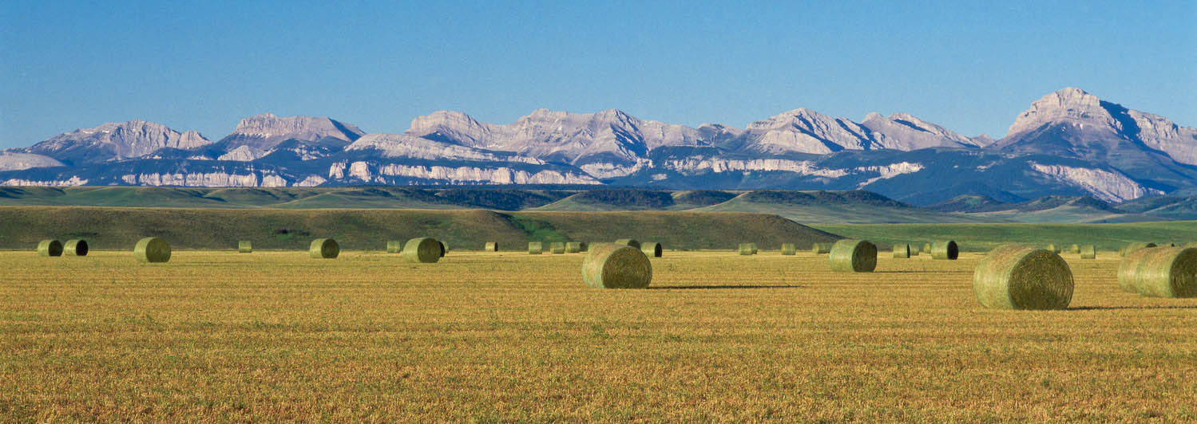
Regional Metamorphism
Recall: Regional Metamorphism is the result of high pressures and elevated temperature associated with mountain building.

Slide 4
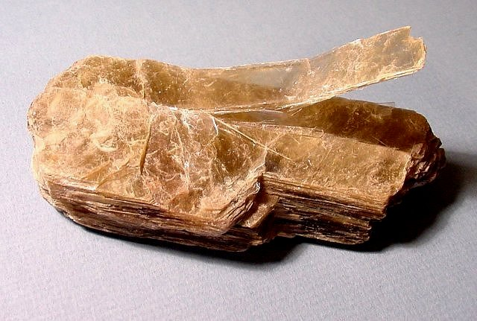
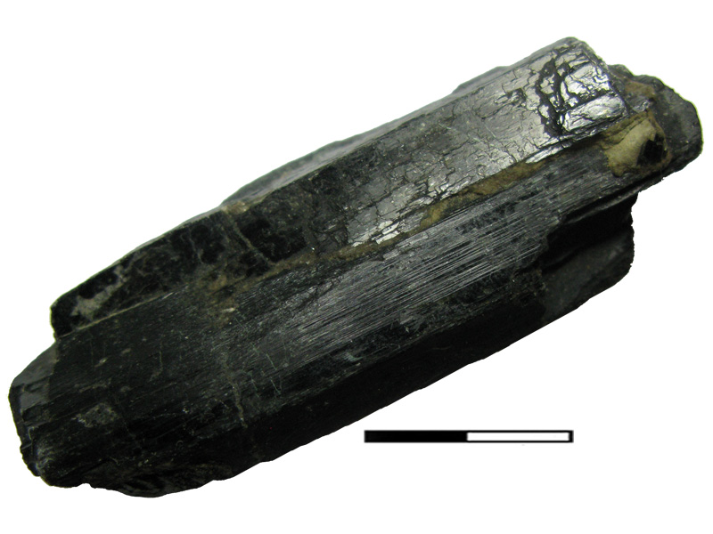
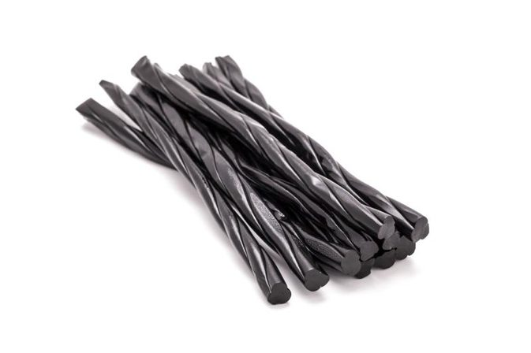
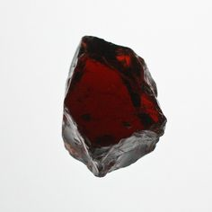
Regional Metamorphism
Platy minerals (micas) and elongate minerals (hornblende) recrystallize and/or rotate into a new orientation perpendicular to the applied stress, while other minerals recrystallize into new crystals which are stable at the higher pressures and temperatures.
micas
hornblende
garnet

Slide 5
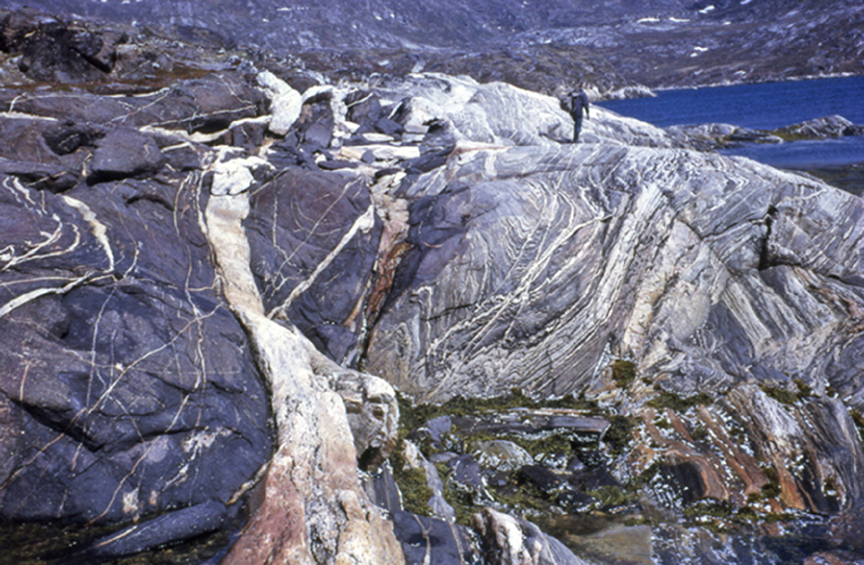

Slide 6
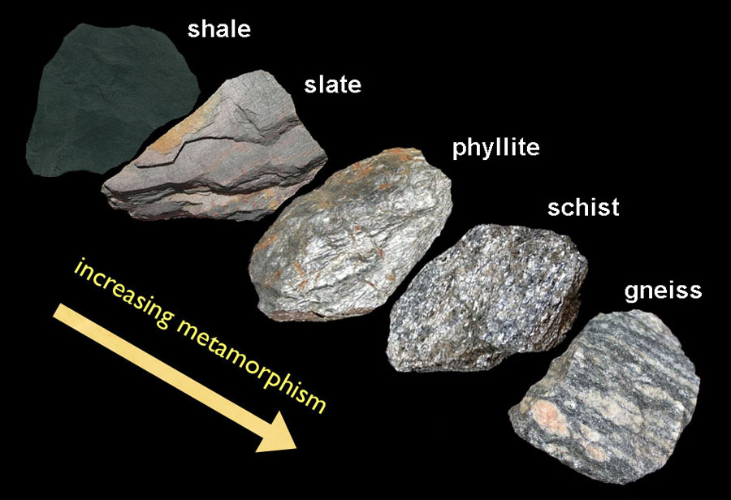
Regional Metamorphism
Example

Slide 7
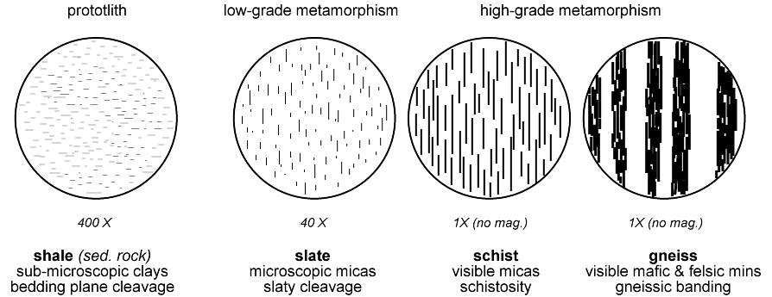
Regional Metamorphism
With increased pressure and temperature the minerals begin to fuse together forming foliated layers.

Slide 8
Regional Metamorphism
Examine the rocks at your table and arrange them in correct order of metamorphism.
Shale
Slate
Phyllite
Schist
Gneiss

Slide 9
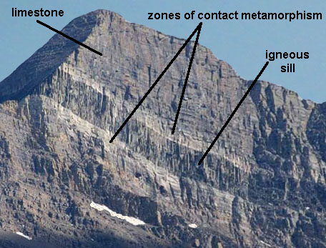
Contact Metamorphism
Recall: Contact Metamorphism is the result of baking the surrounding rock by an igneous intrusion.

Slide 10
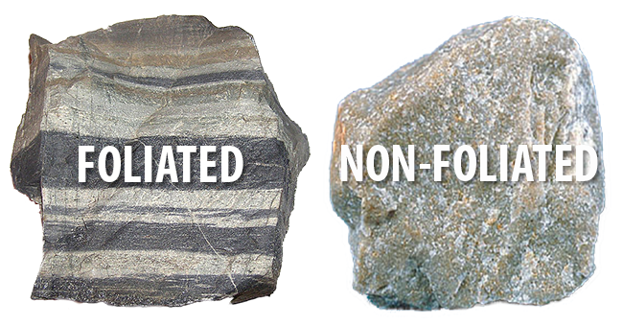
Contact Metamorphism
Contact Metamorphism produces rocks that are non-foliated.

Slide 11
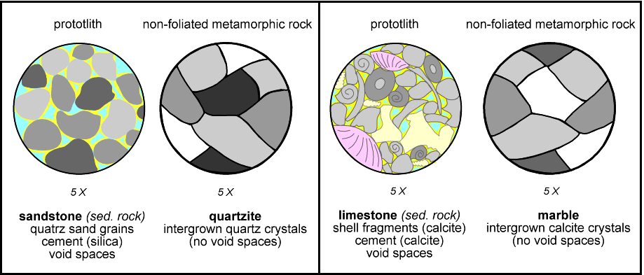
Contact Metamorphism
Contact Metamorphism Examples

Slide 12
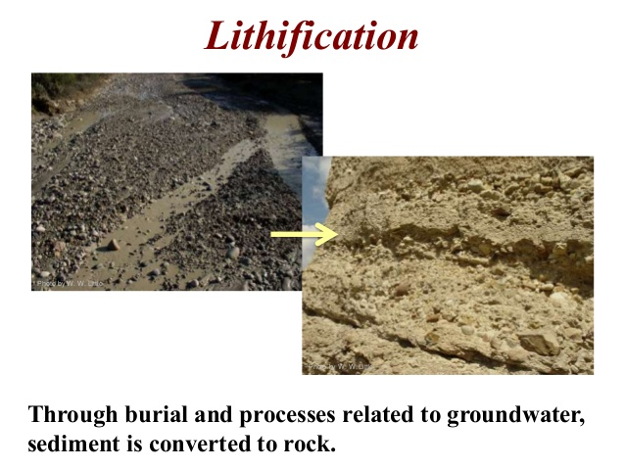
Contact Metamorphism
What is the name of the process that causes sedimentary rock to form?

Slide 13
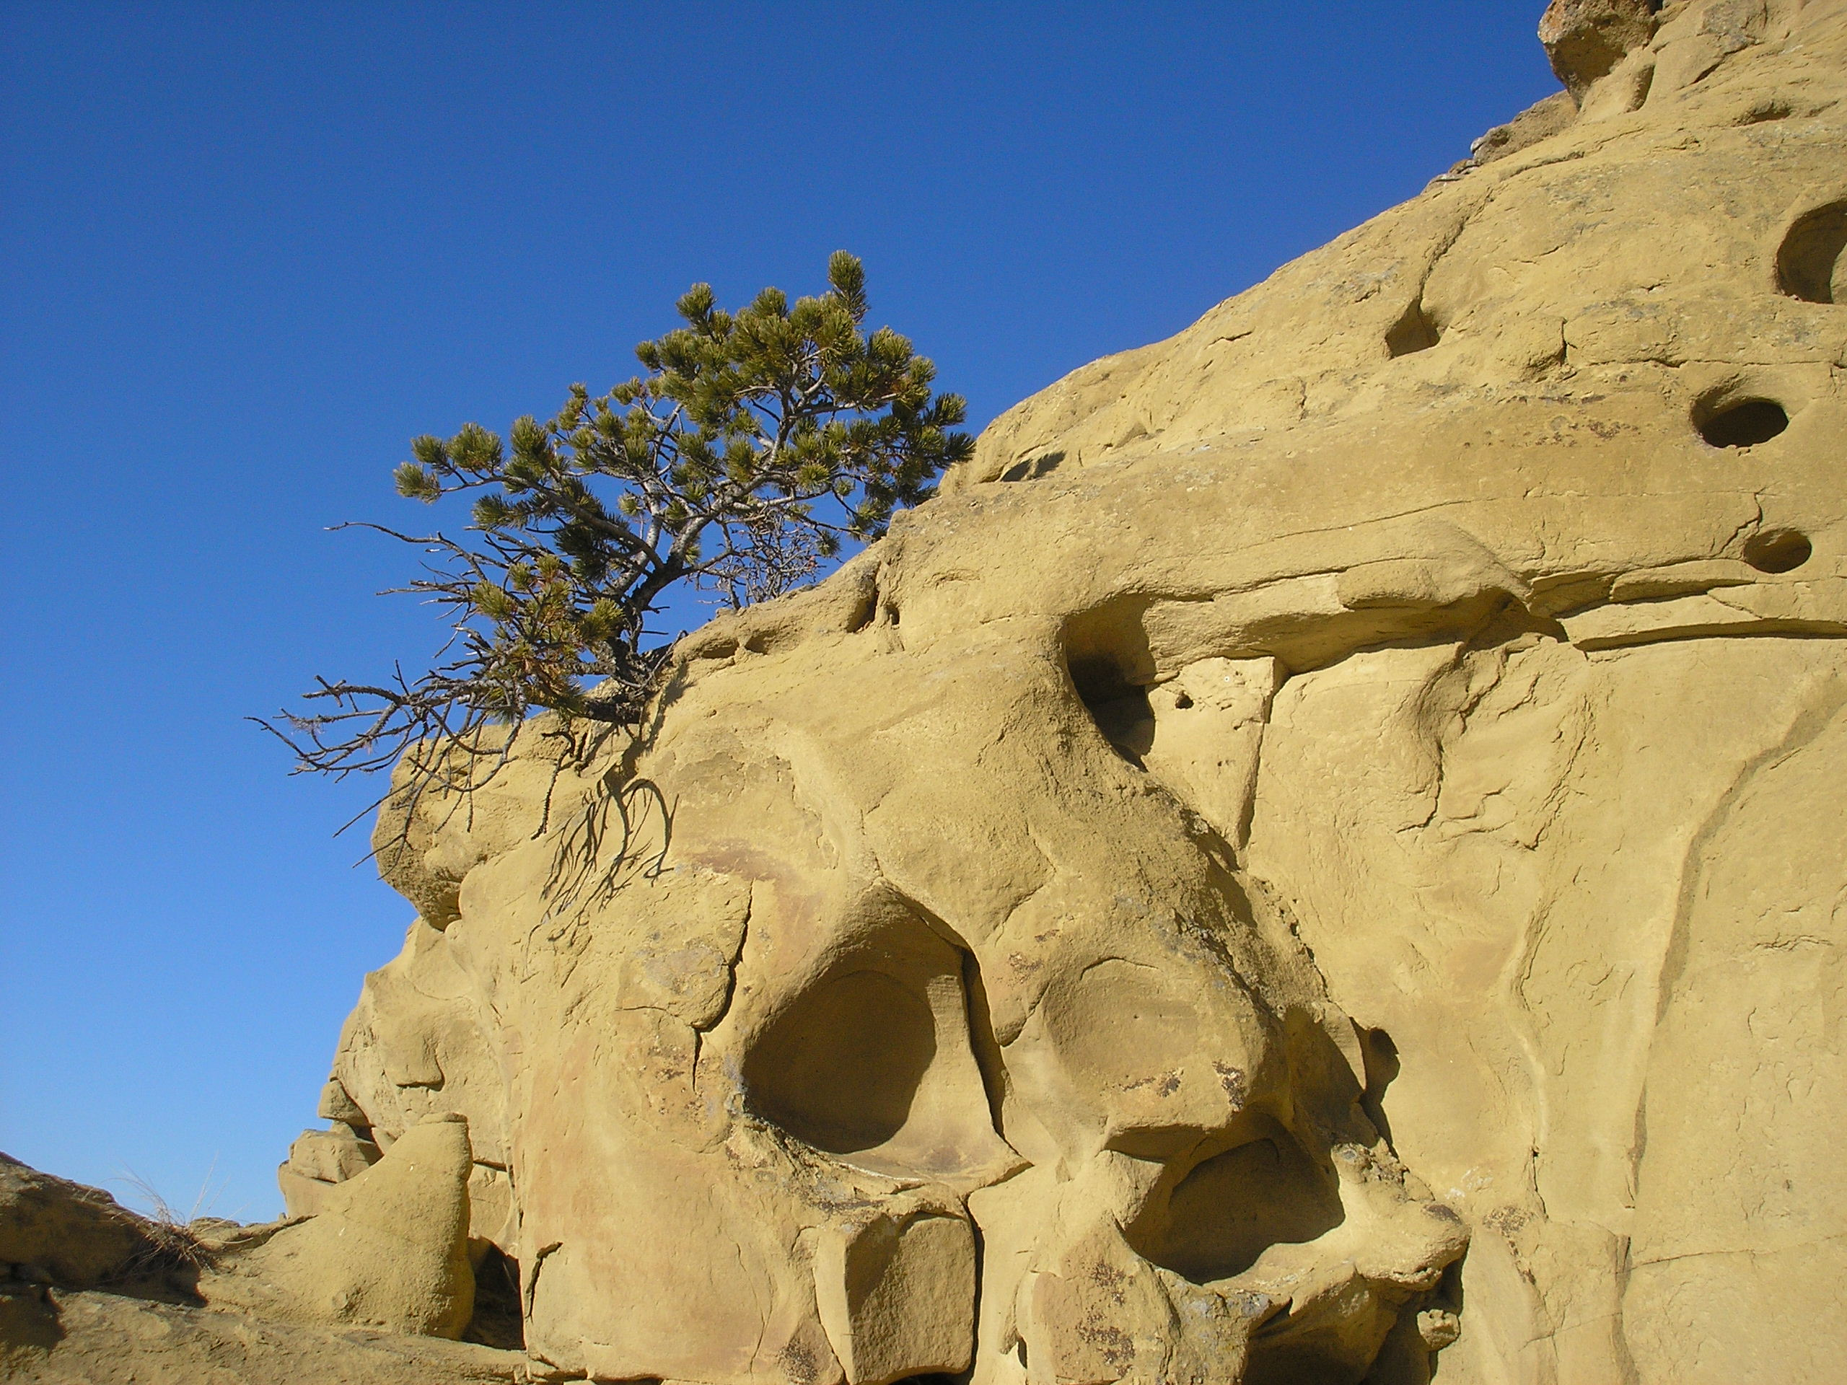
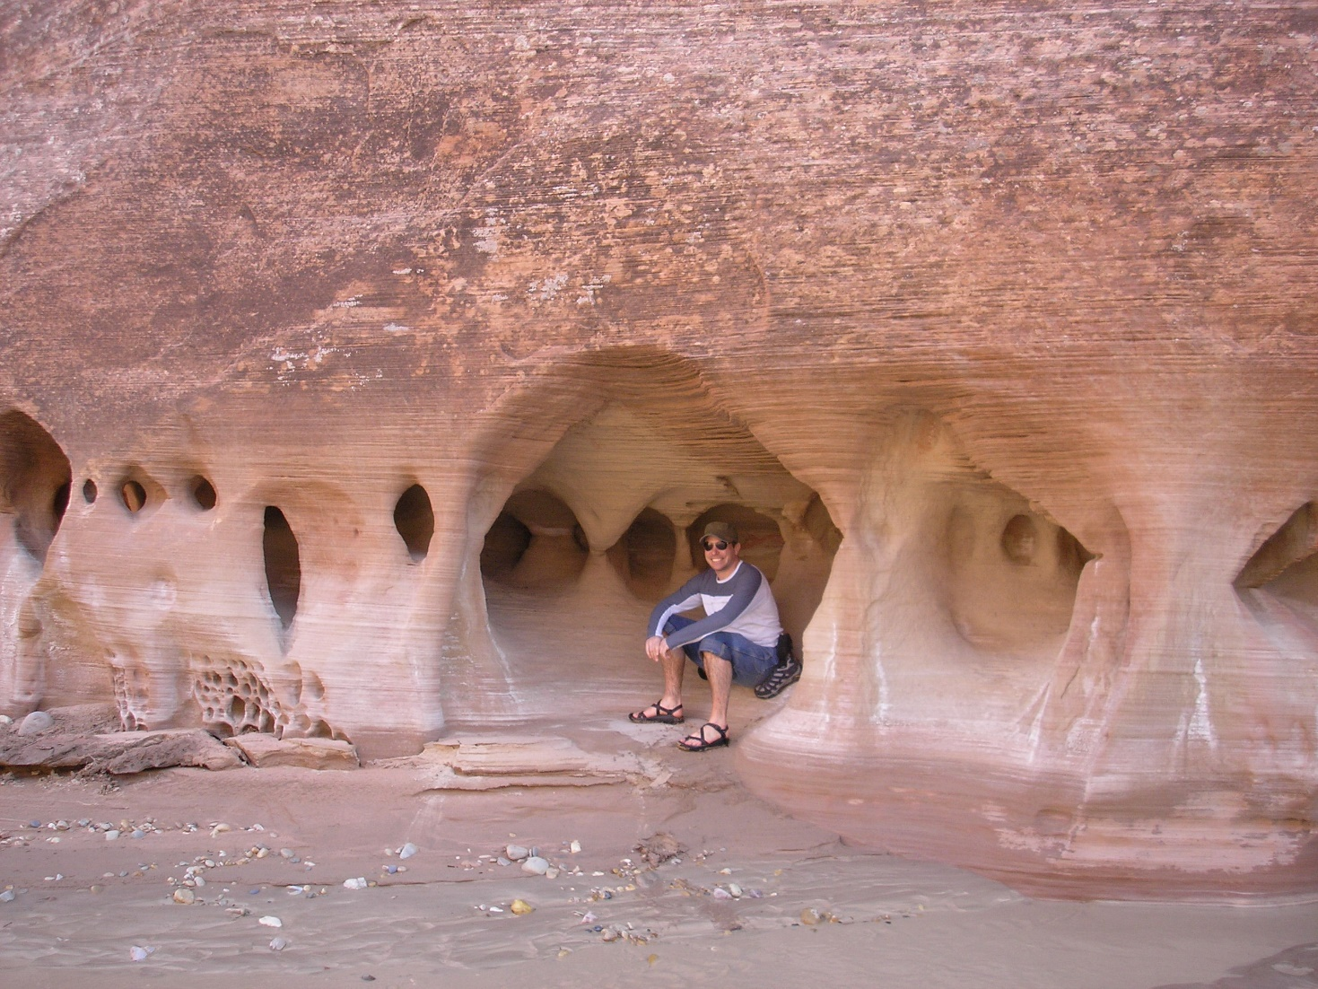
Contact Metamorphism
Sandstone is a clastic sedimentary rock composed mainly of sand-sized minerals or rock grains.
Most sandstone is composed of quartz or feldspar

Slide 14
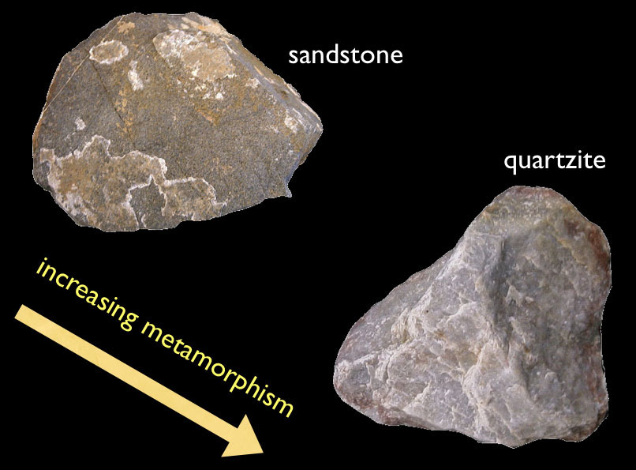
Contact Metamorphism

Slide 15
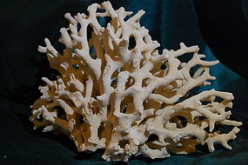
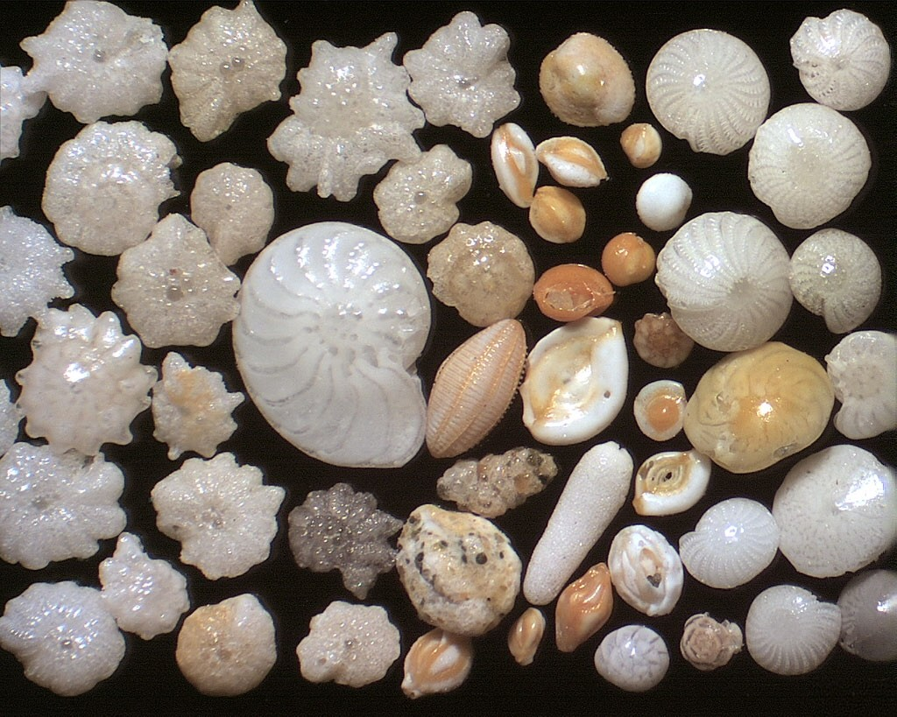
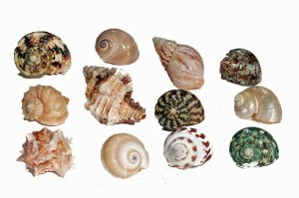
Contact Metamorphism
Limestone - calcium carbonate (CaCO₃).
About 10% of sedimentary rocks are limestones.
coral
forams
molluscs

Slide 16
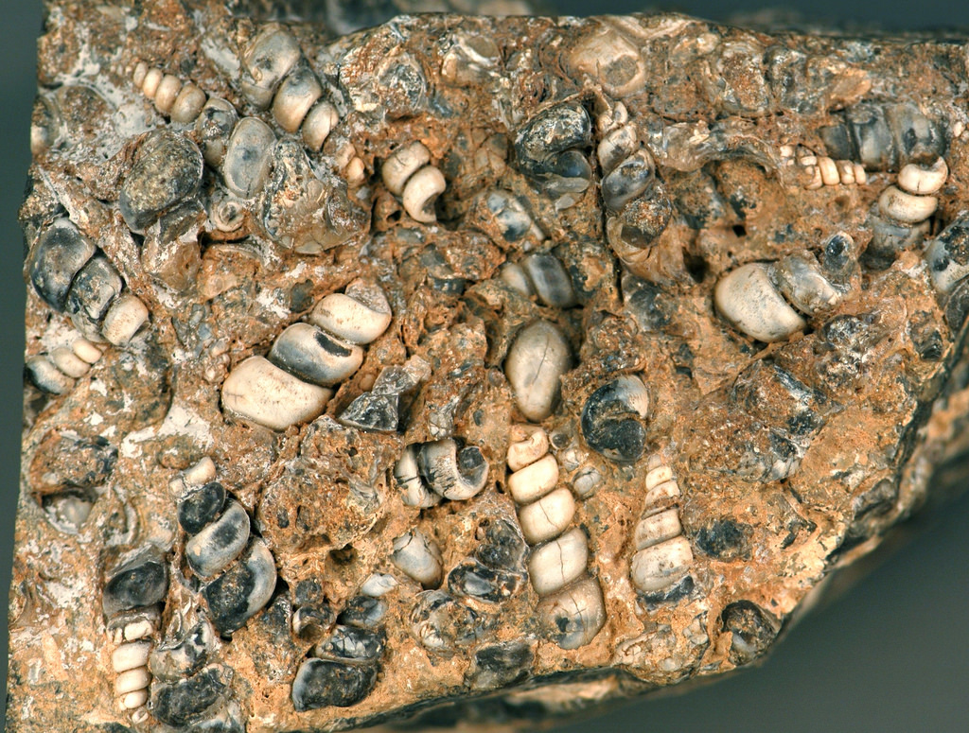
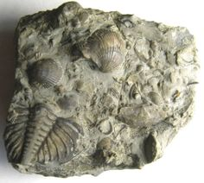
Contact Metamorphism
Limestone is a sedimentary rock that can preserve fossils of organisms.

Slide 17
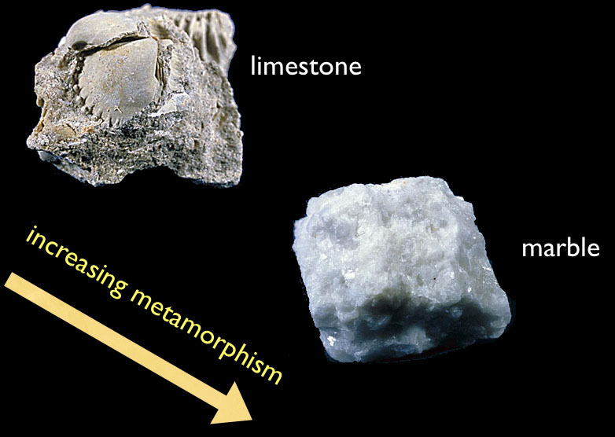
Contact Metamorphism

Slide 18
Contact Metamorphism
Examine the rocks at your table and match each sedimentary sample with its metamorphized counterpart.
Sandstone Quartzite
Limestone Marble

Slide 19
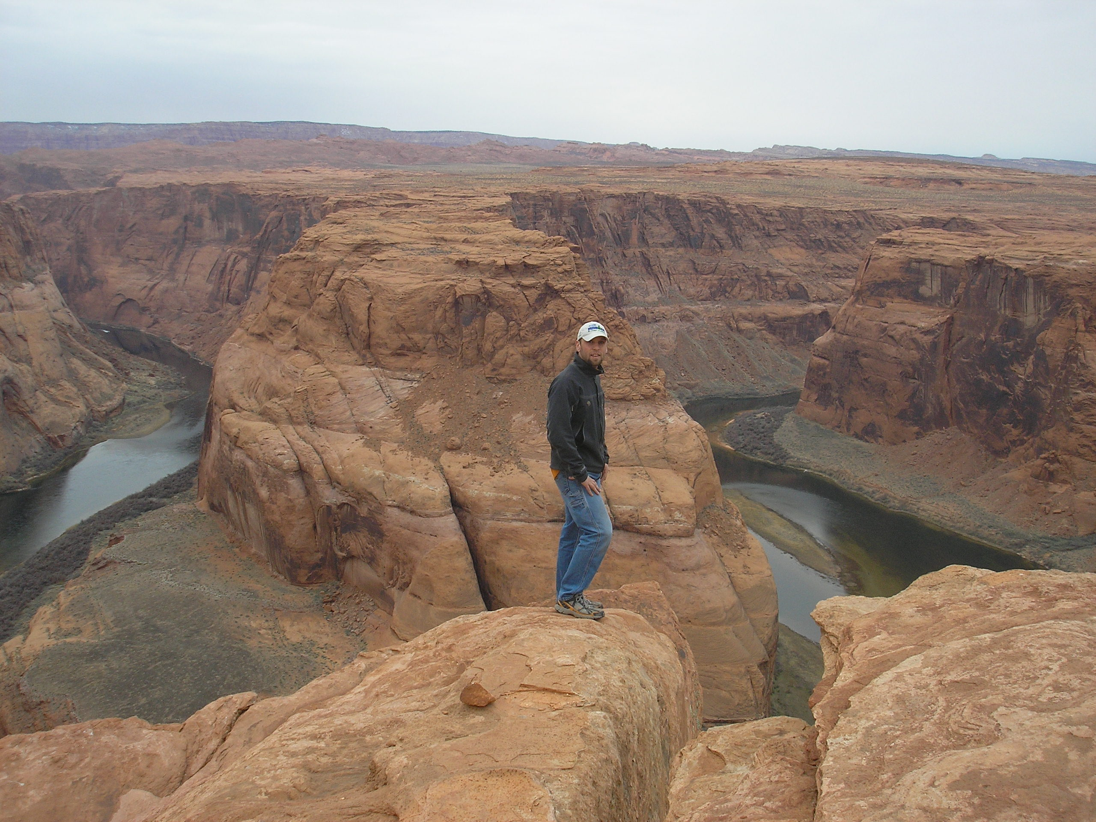
Sandstone
Sedimentary
Clastic
Formation:
Sandy beaches
and ancient deserts

Slide 20
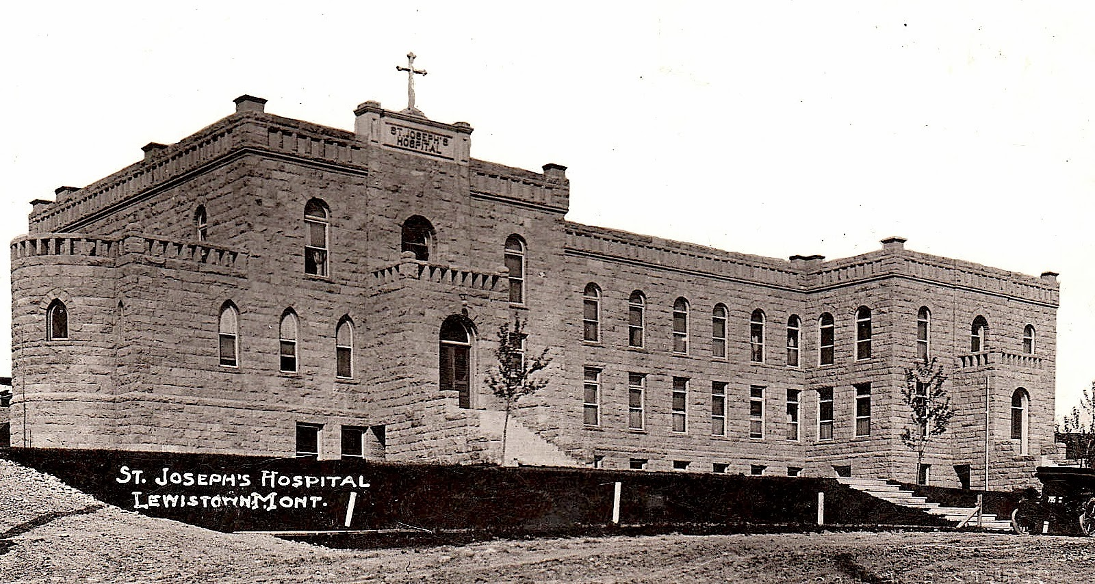
Sandstone
Uses:
Stone buildings

Slide 21
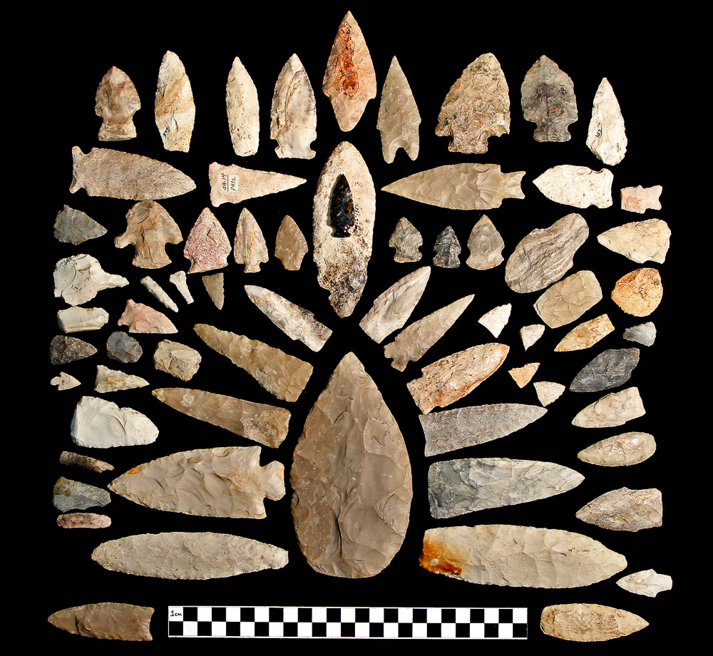
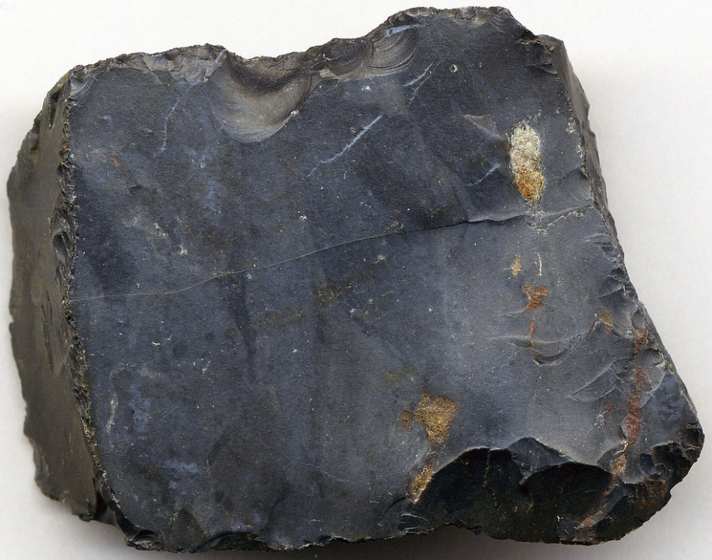
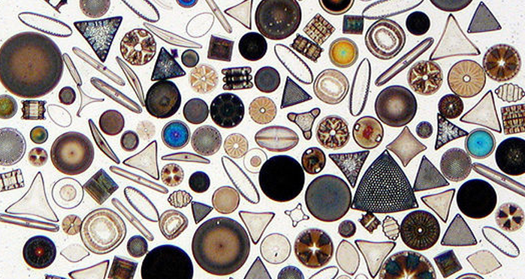
Chert
Sedimentary, chemical
Formation:
Near water
Uses:
Arrowheads, primitive tools
Made from the crystallization of SiO2 rich water
Often from the decomposition of Diatoms

Slide 22
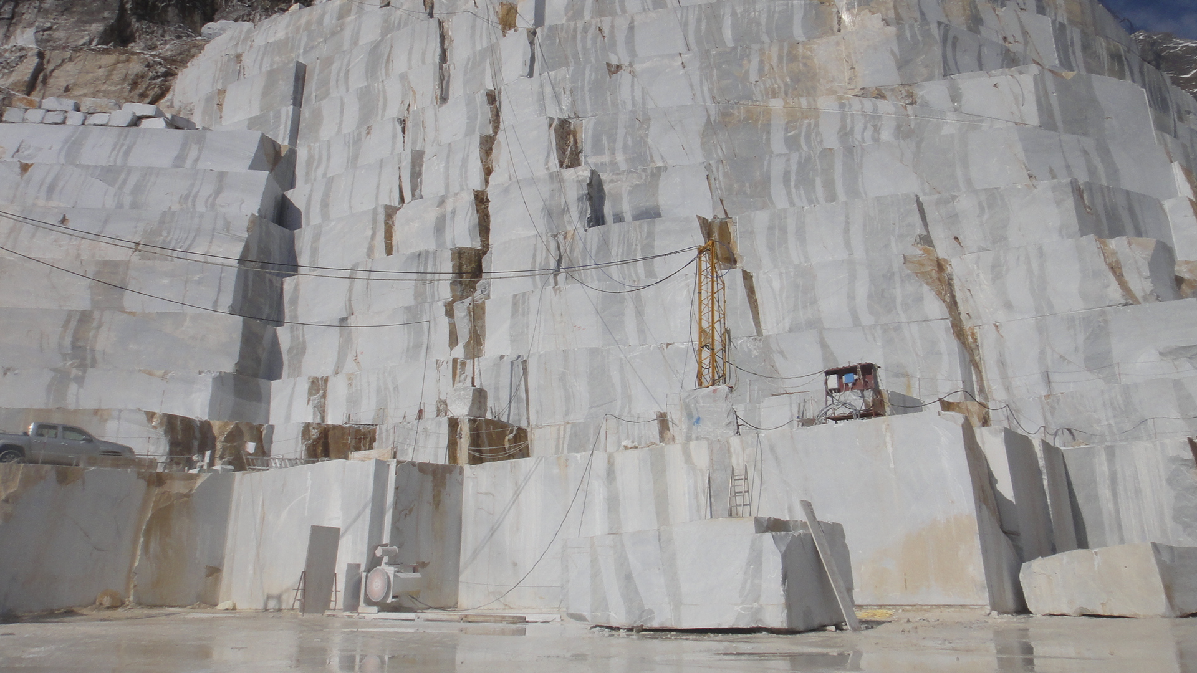
Marble
Metamorphic
Formation:
Contact metamorphism
Uses:
Statues, decorative stone

Slide 23
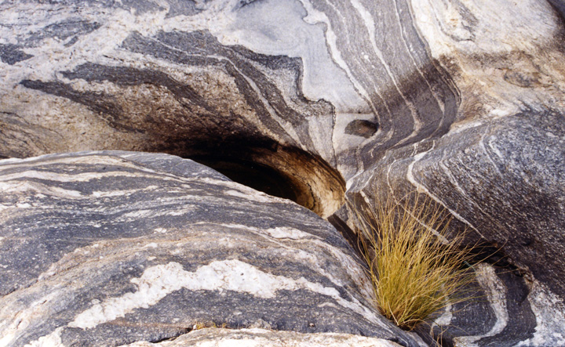
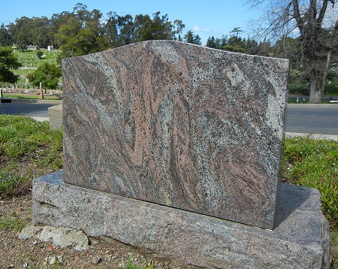
Gneiss
Metamorphic
Formation:
Convergent plate boundaries
Uses:
Decorative stonework

Slide 24
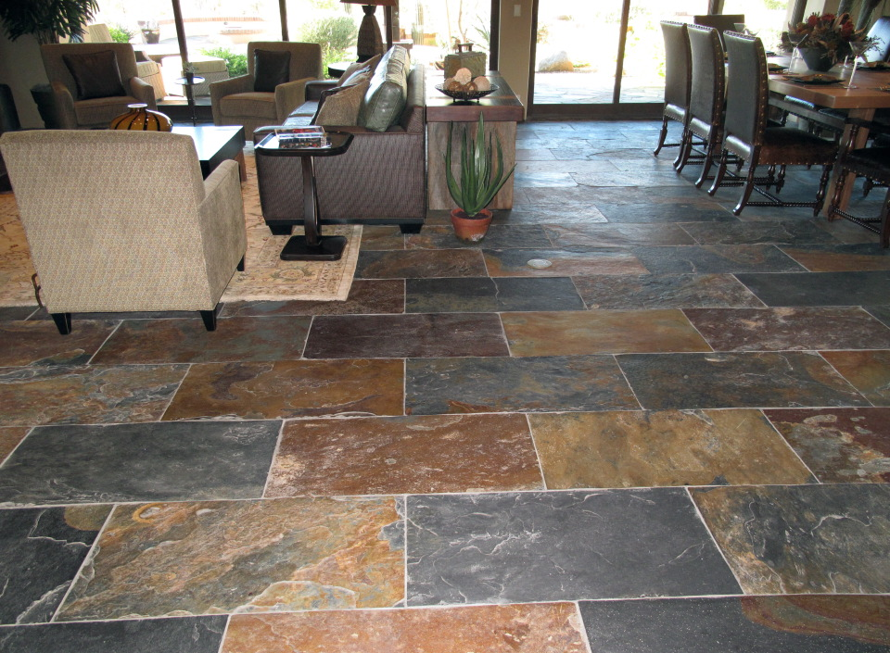
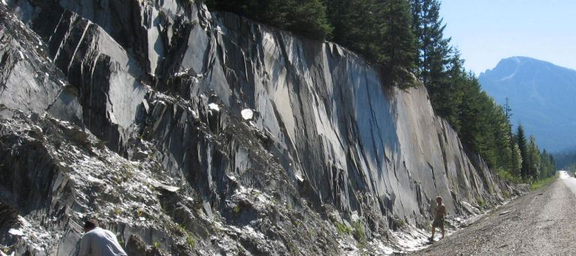
Slate
Metamorphic
Formation:
Regional metamorphism
at fault boundaries
Uses:
Flooring roofing material

Slide 25
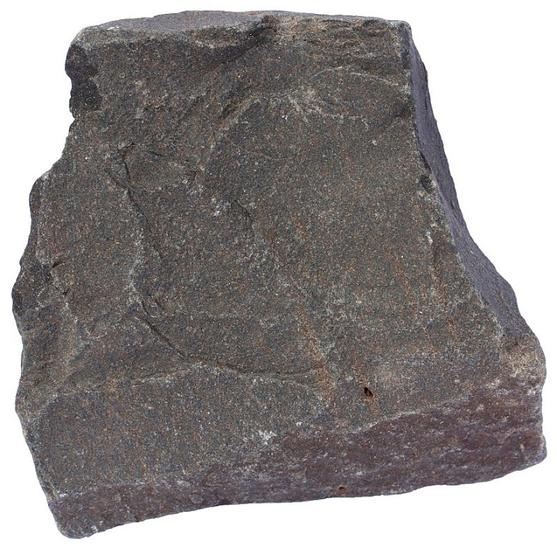
Basalt
Igneous, mafic
Formation:
Volcanic area
Uses:
Asphault

Slide 26
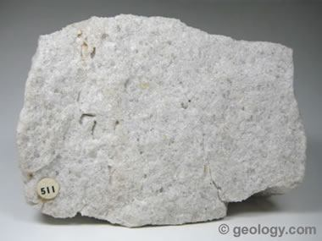
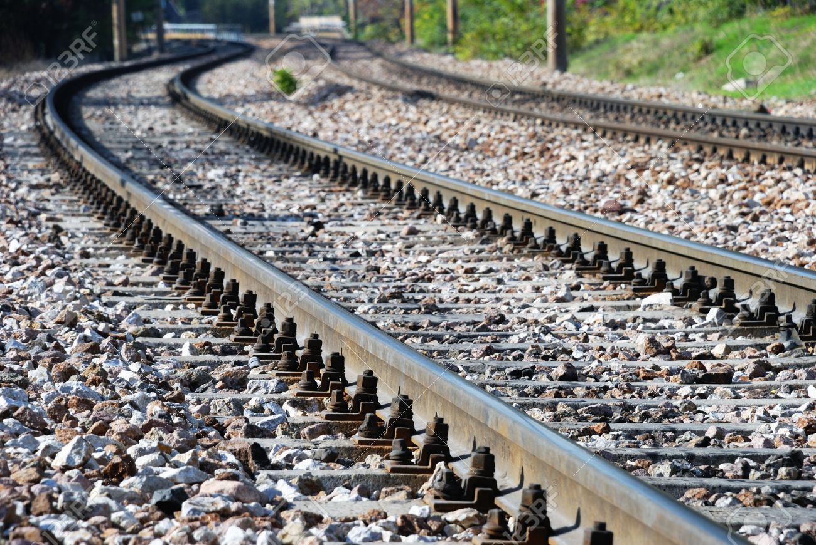
Rhyolite
Igneous, felsic
Formation:
Volcanic areas
Uses:
Gravel, railroad ballast

Slide 27
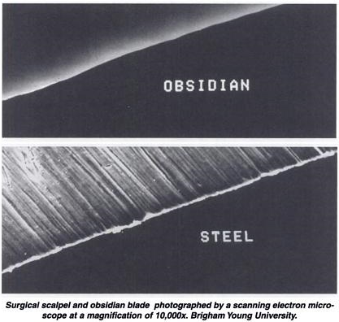
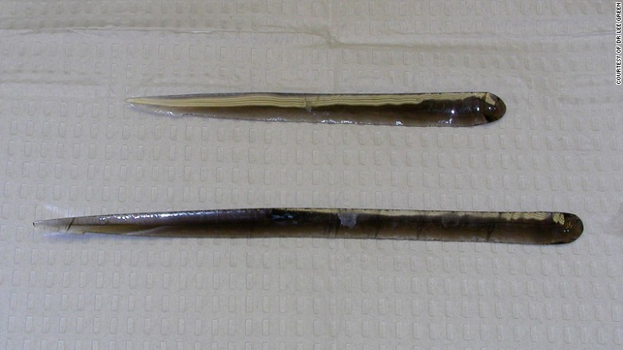
Obsidian
Igneous, felsic
Formation:
Rapid cooling volcanic glass
Uses:
Arrowhead, projectile points
Surgical blades

